Slide 1
FROM EXCEL TO EXCELLENT
Using Excel Objects

Slide 2
GRADING
20% Midterm Project
20% Final Project (Oct 18,2023)
20% Assignment
20% Midterm Examination
20% Final Examination

Slide 3
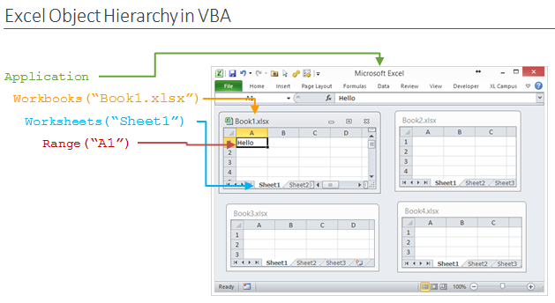

Slide 4
Programming
with
Workbooks and Worksheets

Slide 5
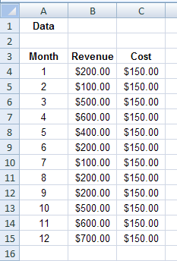
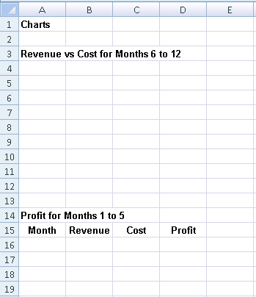
Workbooks and Worksheets
Example 1: Write a module to take some values from workbook Workbook1 and transfer them for analysis into workbook Workbook2
Workbook1
Workbook2

Slide 6
Workbooks and Worksheets
Example 1: Solution
- Open both workbooks in Excel
- Create a module in Workbook2
Sub Macro1()
Windows("Workbook1.xlsx").Activate
Range("A4:C15").Select
Selection.Copy
Windows("Workbook2.xlsx").Activate
Range("A16").Select
ActiveSheet.Paste
End Sub

Slide 7
Workbooks and Worksheets
Example 2: Write a module to hides all worksheets of Workbook3, but the welcome sheet, when the application is opened.

Slide 8
Workbooks and Worksheets
Example 2: Solution
The code to accomplish this effect should be written in a sub procedure associated with the Open event of the Workbook object
The following code hides all worksheets, but the welcome sheet, when the application is opened.
Workbook3 Example
Private Sub Workbook_Open()
Worksheets("Welcome").Visible = True
Worksheets("Input").Visible = False
Worksheets("Analysis").Visible = False
Worksheets("Output").Visible = False
End Sub

Slide 9
Programming with Ranges

Slide 10
Range
Example 3: Write a module to create a solid, red range of “A1:F12” on the “Welcome” sheet of Workbook3.

Slide 11
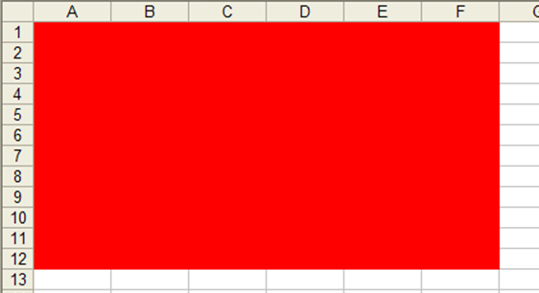
Range
Example 3: Solution
  Range(“A1:F12”).Interior.ColorIndex = 3
  Range(“A1:F12”).Interior.Color = vbRed

Slide 12
Range: Color Format
The Interior property is used to change the color of the cell(s) within a range
There are a few sub properties that can be used
  ColorIndex
  Color
  Pattern

Slide 13
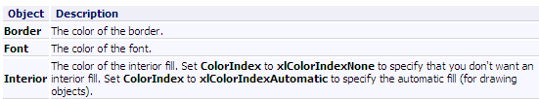
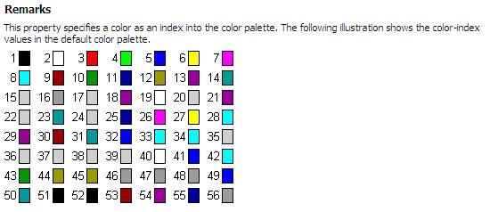
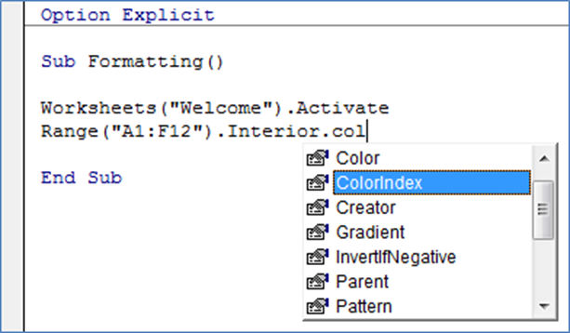
Range: Color Format
ColorIndex property
  Value = numerical color index

Slide 14
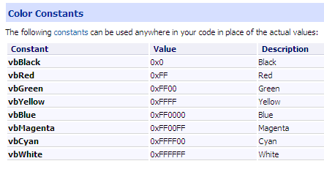
Range: Color Format
Color property
  Value = VB Constant or RGB Function

Slide 15
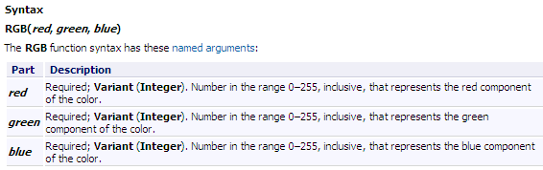
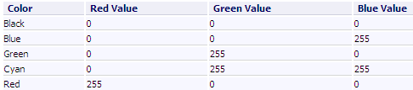
Range: Color Format
Color property
  Value = VB Constant or RGB Function

Slide 16
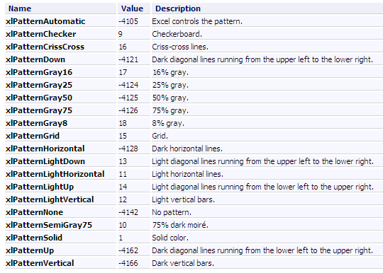
Range: Color Format
Pattern property
  Value = XL Constant

Slide 17
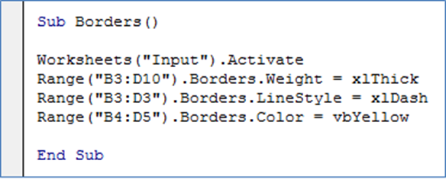
Range: Border Format
Example 4: Show output of the following module on the “Input” sheet of Workbook3.

Slide 18
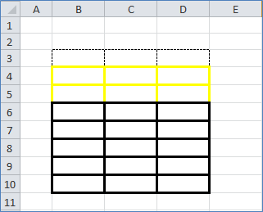
Range: Border Format
Example 4: Solution

Slide 19
Range: Border Format
The Borders property has several sub properties
  LineStyle
    Value = xlDashed, xlSolid, …
  Weight
    Value = xlThick, xlThin, …
  Color
    Value = VB Constant, RGB Function
  XL Constants
    xlInsideHorizontal, xlEdgeBottom, …

Slide 20
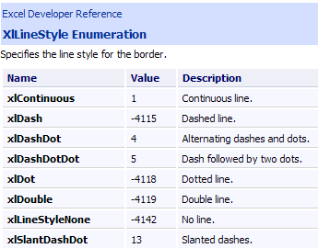
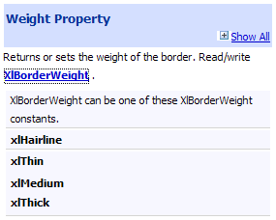
Range: Border Format
Values for sub properties LineStyle and Weight

Slide 21
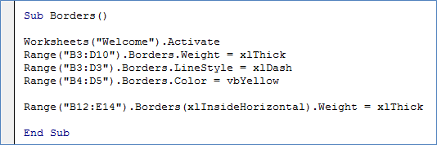
Range: Border Format
Example 5: Show output of the following module on the “Welcome” sheet of Workbook3.

Slide 22
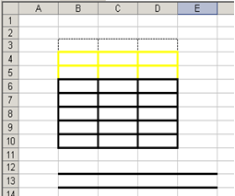
Range: Border Format
Example 5: Solution
We specify a new range Range(“B12:E14”) and set the Borders property to xlInsideHorizontal so that each row of our range has a line above and below it.
We set the weight of this border to xlThick.

Slide 23
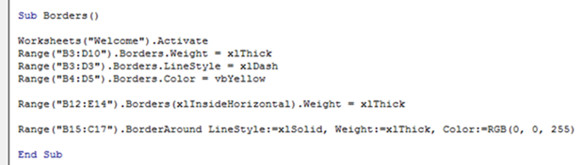
Range: Border Format
Example 6: Show output of the following module on the “Input” sheet of Workbook3.

Slide 24
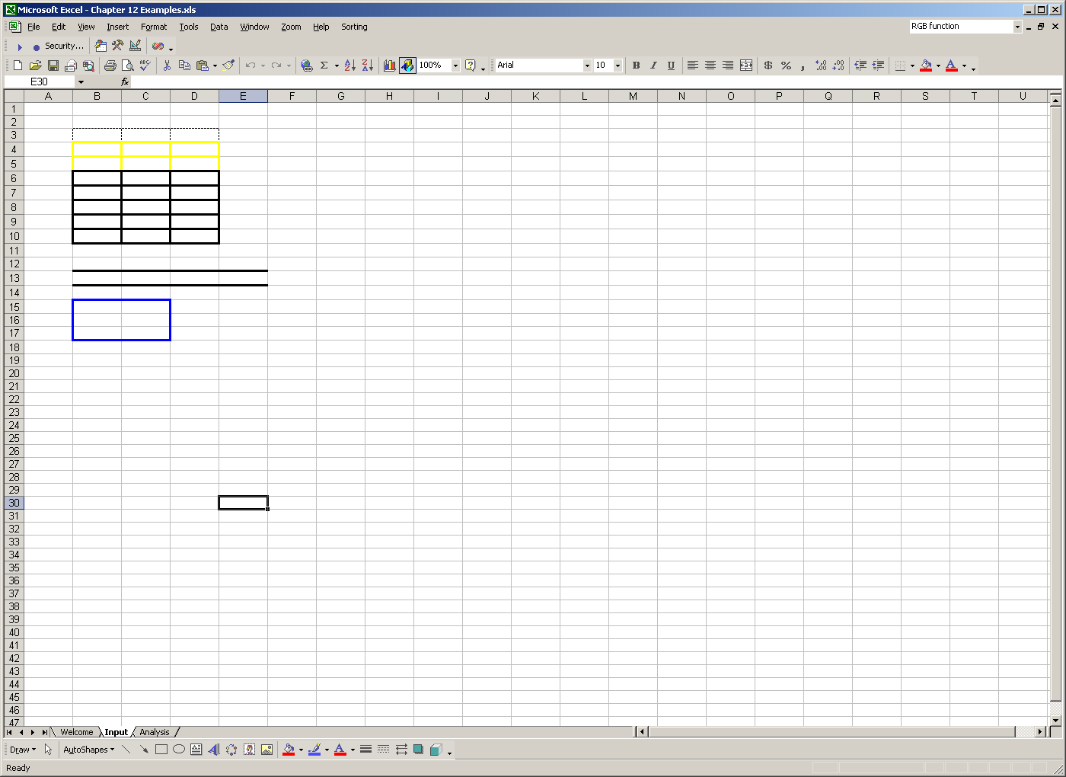
Range: Border Format
Example 6: Solution

Slide 25
Range: Border Format
The BorderAround method has several possible arguments
  LineSytle:= xlDash, xlSolid, …
  Weight:= xlThick, xlThin, …
  Color:= VB Constant, RGB Function
Notice that a combination of a colon and an equal sign are used to define the argument of the method (:=)
  This is different than the values of properties that are set using just an equal sign (= )

Slide 26
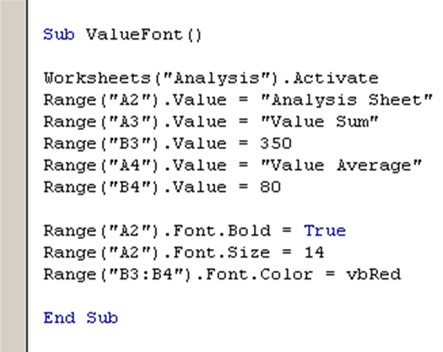
Range - Values
Example 7: Show output of the following module on the “Analysis” sheet of Workbook3.

Slide 27
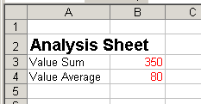
Range - Values
Example 7: Solution

Slide 28
Range - Values
Values are assigned to Ranges in VBA using the Value property.
The value of a range or cell can be
  Text string
  Numerical value
  Basic Formula
  Variable value

Slide 29
Font Format
The Font property is used to format fonts of ranges.
There are several sub properties to use with the Font property.
  Bold; value = True or False
  Size; value = number
  Color; value = VB Constant, RGB Function
  ColorIndex; value = number
  FontStyle; value = “style”

Slide 30
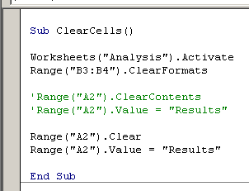
Range – Clearing Contents
Example 8: Show output of the following module on the “Analysis” sheet of Workbook3.

Slide 31
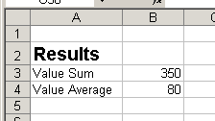
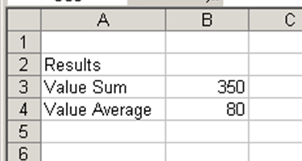
Range – Clearing Contents
Example 8: Solution

Slide 32
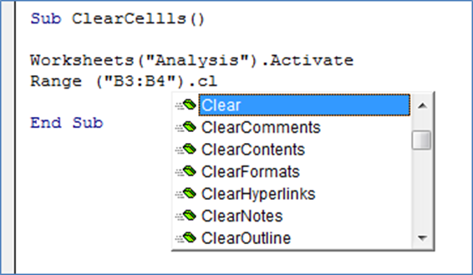
Range – Clearing Contents
There are three methods commonly used to clear a range of cells
  Clear
    Clears everything
  ClearContents
    Only clears values or formulas
  ClearFormats
    Only clears formats

Slide 33
The With Construct
Example 9: Compare two outputs of the following two modules
Range(“A1:C8”).Interior.Color = vbRed
Range(“A1:C8”).Font.Bold = True
Range(“A1:C8”).Font.Name = “Arial”
Range(“A1:C8”).Borders(xlEdgeBottom).LineStyle = xlDash
With Range(“A1:C8”)
.Interior.Color = vbRed
.Font.Bold = True
.Font.Name = “Arial”
.Borders(xlEdgeBottom).
LineStyle = xlDash
End With

Slide 34
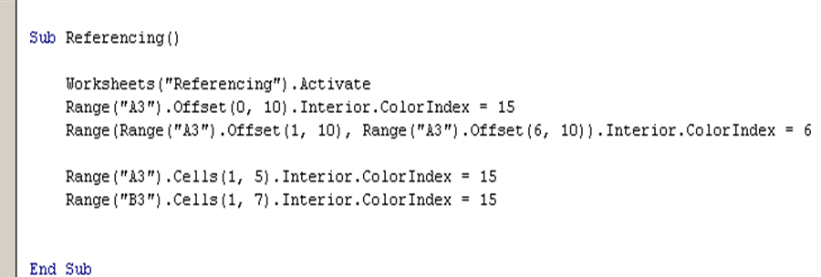
Referencing Ranges in VBA
Example 10: Show output of the following module on the “Referencing” sheet of Workbook4.

Slide 35
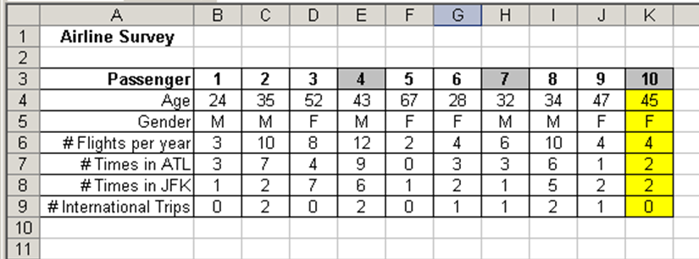
Referencing Ranges in VBA
Example 10: Solution

Slide 36
Referencing Ranges in VBA
There are several ways to reference ranges and cells using VBA
  Offset
  Cells
  Rows
  Columns
  EntireRow
  EntireColumn
  End

Slide 37
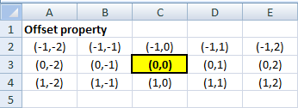
Offset vs Cells
The Offset property
  Considers the upper left-most cell in the range (could be a named range) to be in the 0th row and 0th column
  It offsets the range selection downward by a certain row count (if positive) or upward (if negative) of the range
  It offsets the range selection to the right by a certain column count (if positive) or to the left (if negative) of the range

Slide 38
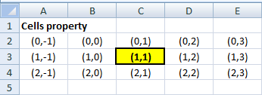
Offset vs Cells
The Cells property
  Considers the upper left-most cell in the range (could be a named range) to be in the 1st row and 1st column
  It then finds the cell in the x^{th} row position below (if the position change is positive) or above (if the position change is negative) and the y^{th} column position to the right (if the position change is positive) or left (if the position change is negative) of the range

Slide 39
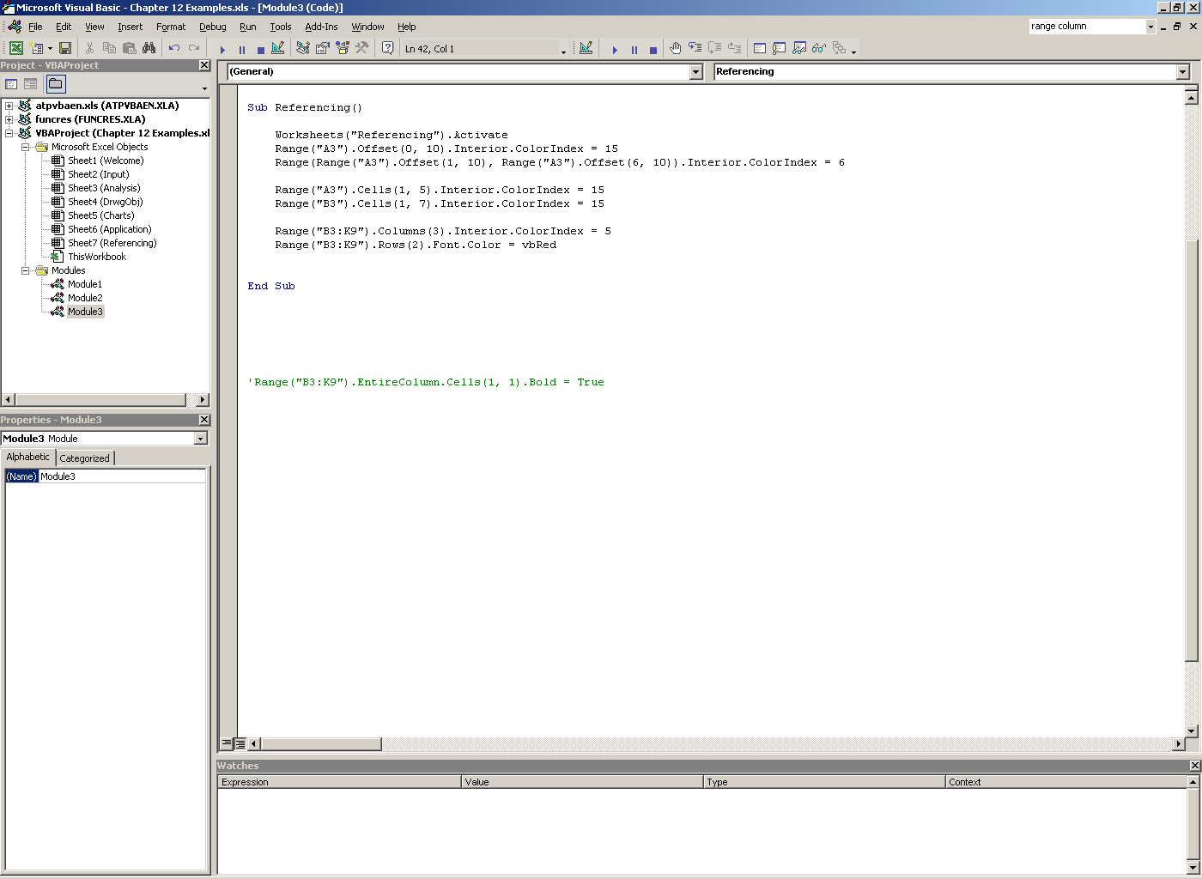
Columns and Rows
Example 11: Show output of the following module on the “Referencing” sheet of Workbook4.

Slide 40
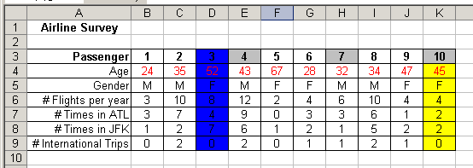
Columns and Rows
Example 11: Solution

Slide 41
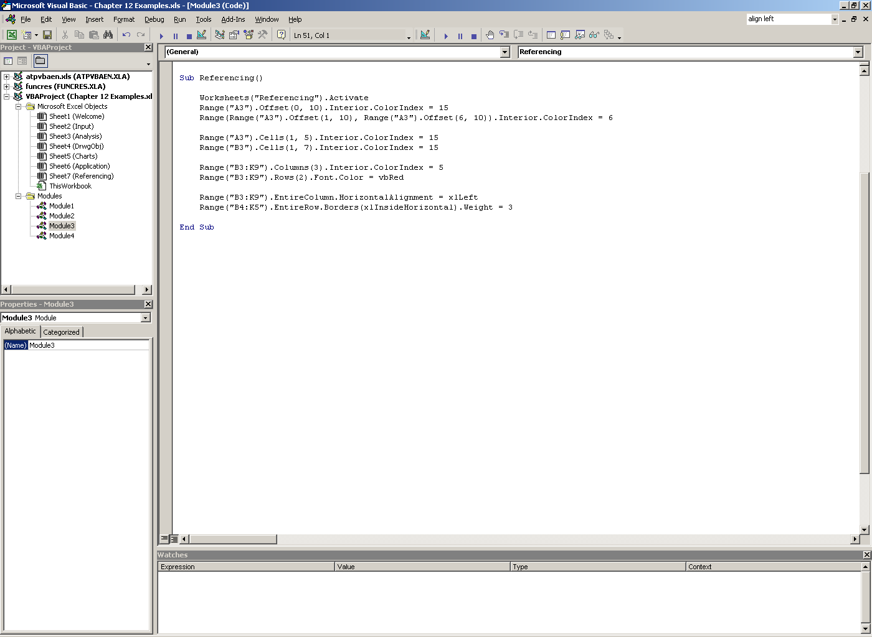
Columns and Rows
Example 12: Show output of the following module on the “Referencing” sheet of Workbook4.

Slide 42
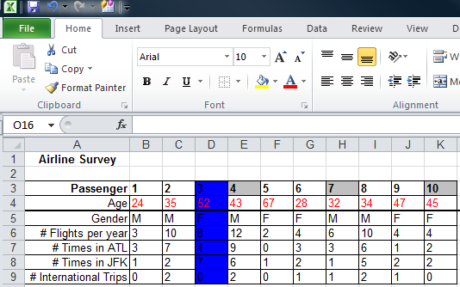
Columns and Rows
Example 12: Solution

Slide 43
Columns and Rows
Columns and Rows, reference columns and rows in a named range, respectively
  Both properties take a numerical index value to find the numbered column within the named range
  Both properties consider the first column or row in the range to be indexed as 1

Slide 44
EntireColumn and EntireRow
EntireColumn and EntireRow, are used to modify every column or row in the named range for the length of the column or row of the entire worksheet.
The EntireColumn property will affect every column in the named range and the EntireRow property will affect every row in the named range for their entire respective length.

Slide 45
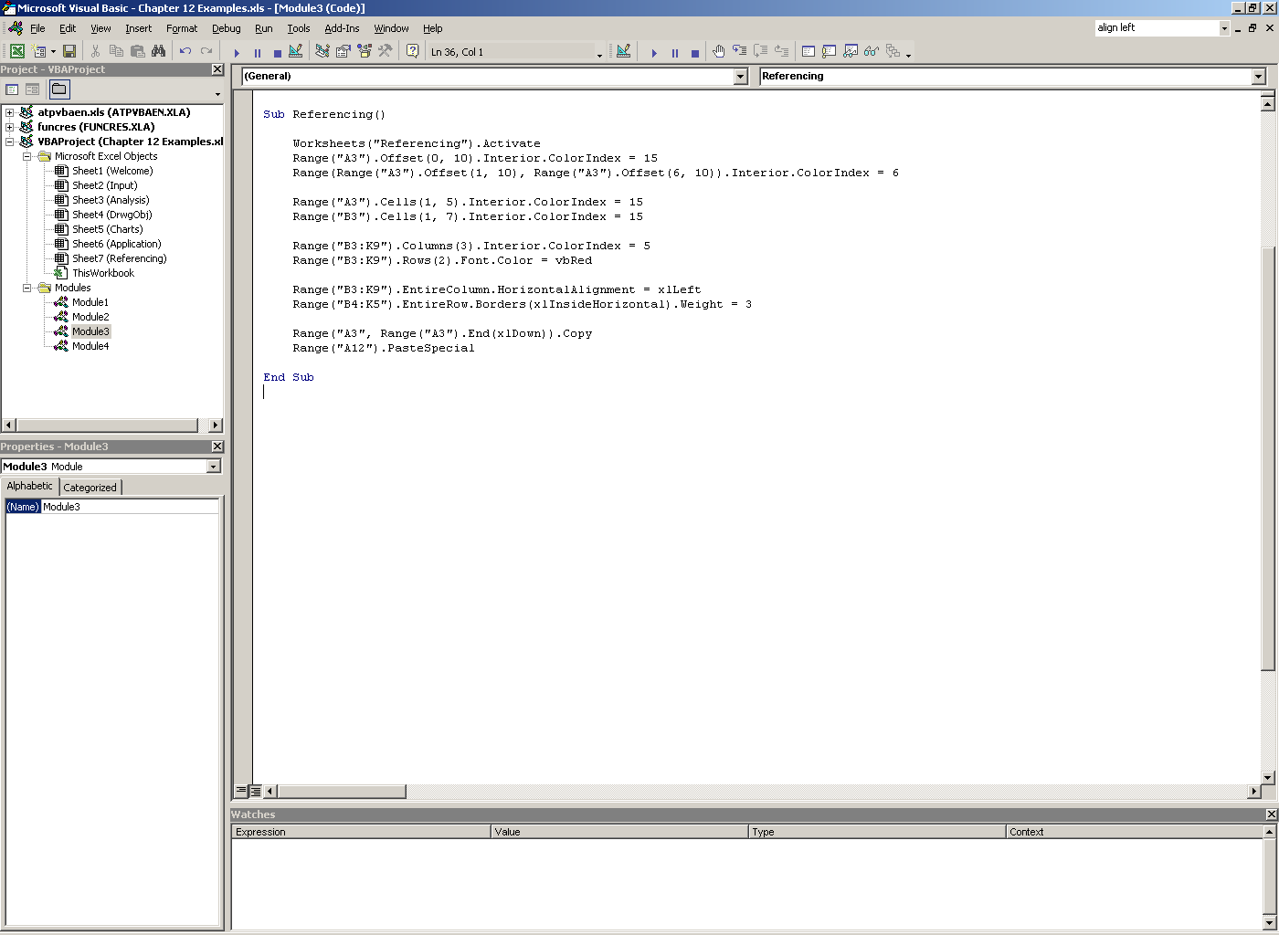
End
Example 13: Show output of the following module on the “Referencing” sheet of Workbook4.

Slide 46
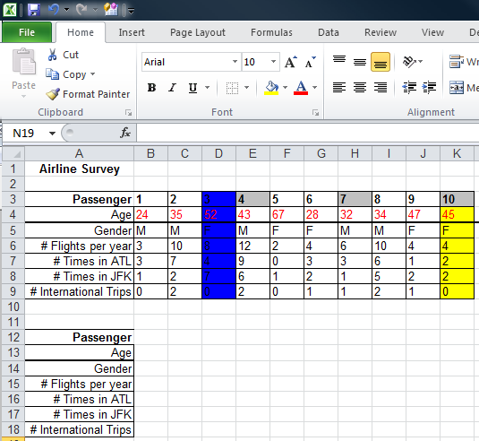
End
Example 13: Solution

Slide 47
End
End is a very useful property as it can help you find the end of a row or a column of any range of data
The End property can take four values
  For columns
    xlDown and xlUp
  For rows
    xlToRight and xlToLeft
You do not need to name an entire data range to use this property, just one cell in the data range is fine

Slide 48
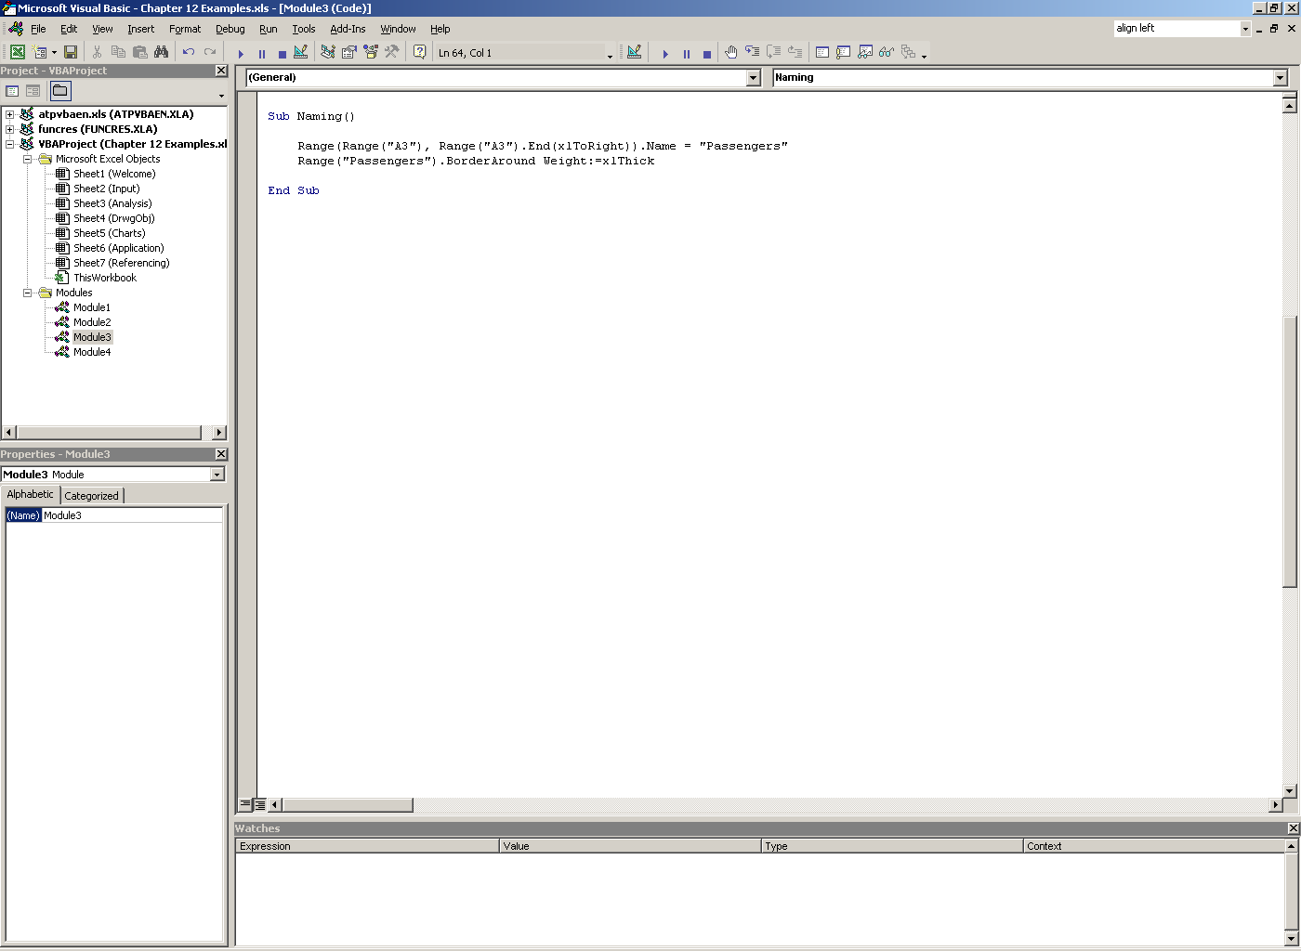
Naming Ranges
Example 14: Run Naming() sub and observe output. Identify range with named “Passengers”.

Slide 49
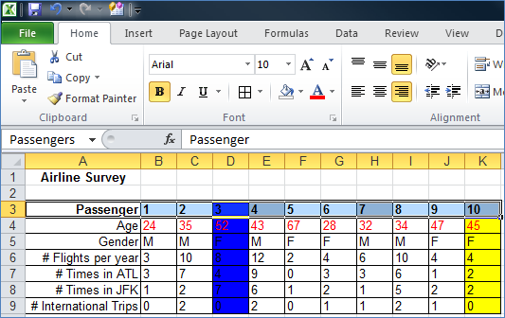
Naming Ranges
Example 14: Solution

Slide 50
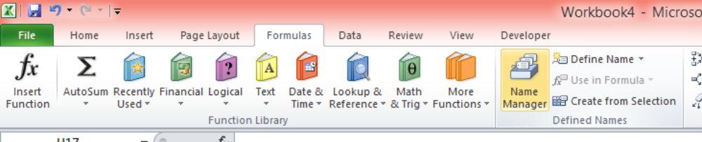
Naming Ranges
The most common way to assign object names is by using the Name property.
When you name a range in Excel (using Formulas > Defined Names > Define Name command on the Ribbon), the name appears in the name window whenever the corresponding range is selected. The same occurs after naming a range in VBA.

Slide 51
Programming with Formulas
Formulas with the Range Object

Slide 52
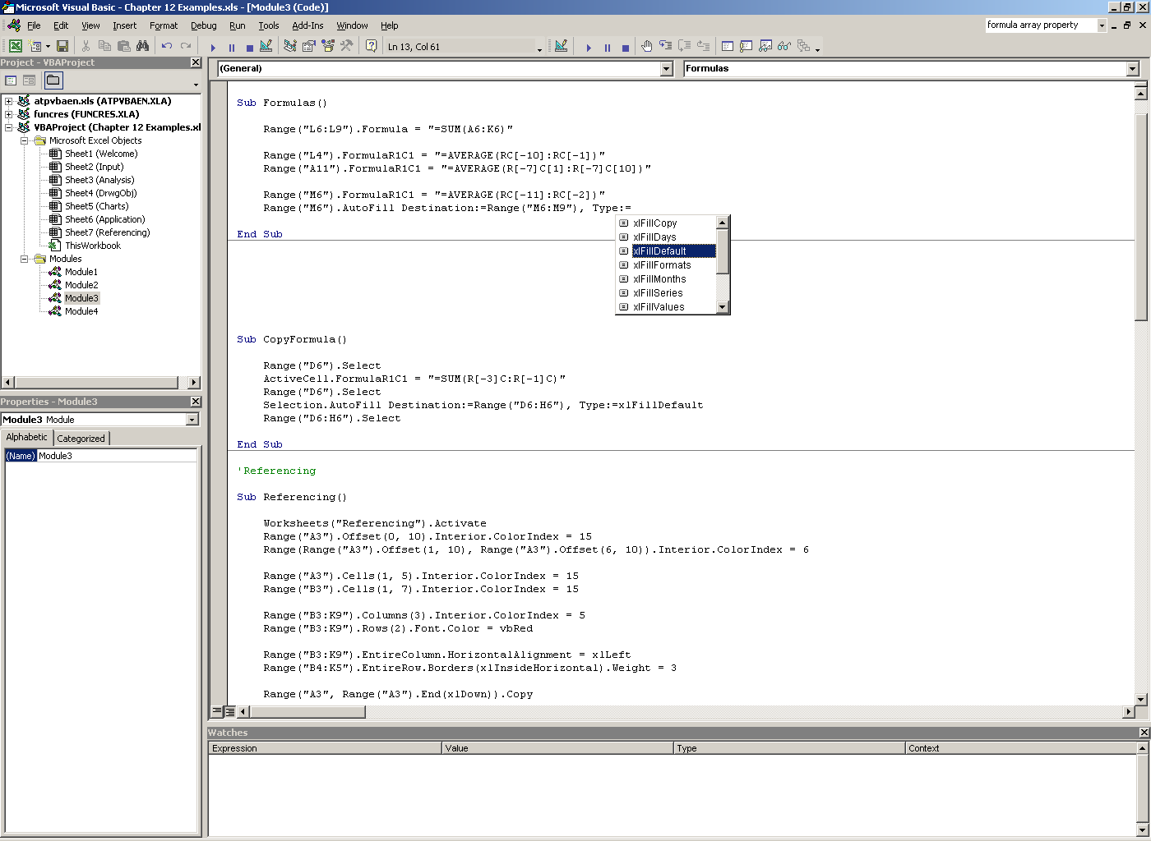
Formulas with the Range Object
Example 15: Show output of the following module on the “Referencing” sheet of Workbook4.

Slide 53
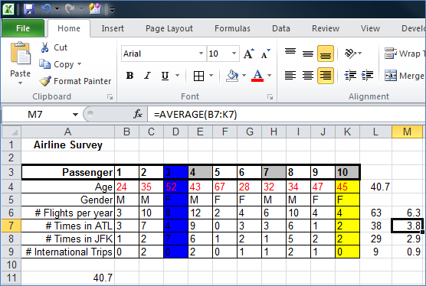
Formulas with the Range Object
Example 15: Solution

Slide 54
Formulas with the Range Object
Two main properties can be used with the Range object
  Formula; value = reference by column letter and row number
  FormulaR1C1; value = reference by R1C1 Notation
A cell or an entire range of cells, or array, can be used with these properties.
There is also one method we can use with the Range object concerning formulas.
  AutoFill; arguments = Destination, Type

Slide 55
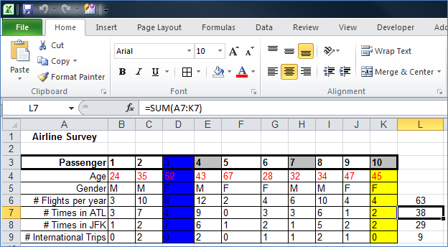
Formulas with the Range Object
We will calculate some sums and averages using both the Formula and FormulaR1C1 properties.
Since relative referencing is used, the formula will automatically modify for each relative row of data.

Slide 56
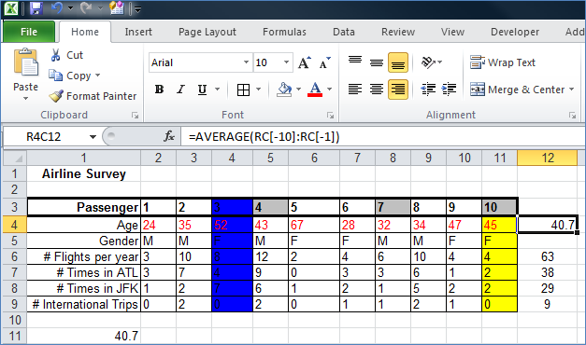
Formulas with the Range Object
We use R1C1 Notation to calculate the average age of passengers in the table.

Slide 57
Programming with Formulas
Formulas with the Application Object

Slide 58
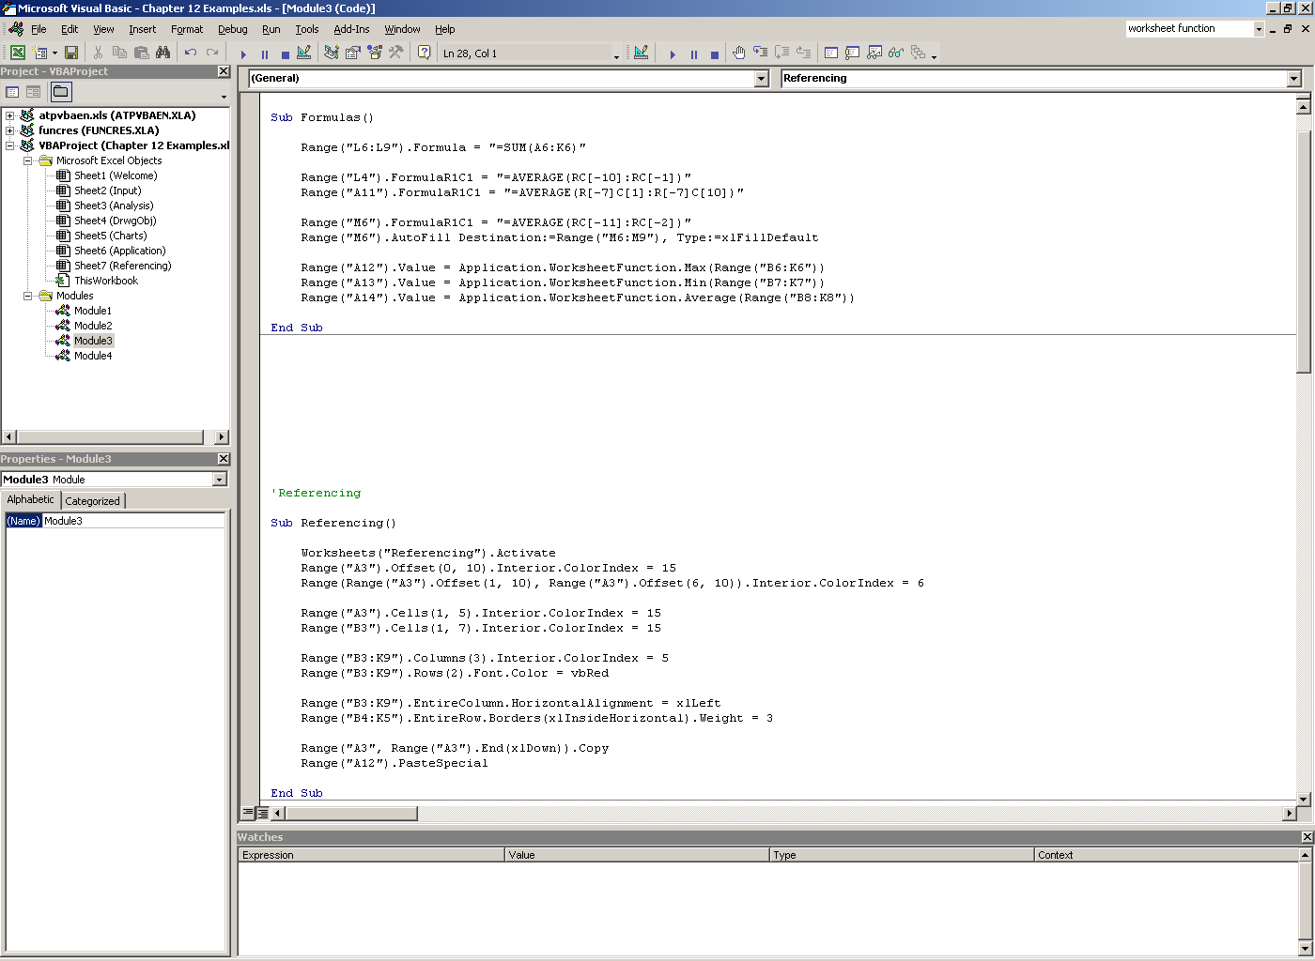
Formulas with Application Object
Example 16: Show output of the following module on the “Referencing” sheet of Workbook4.

Slide 59
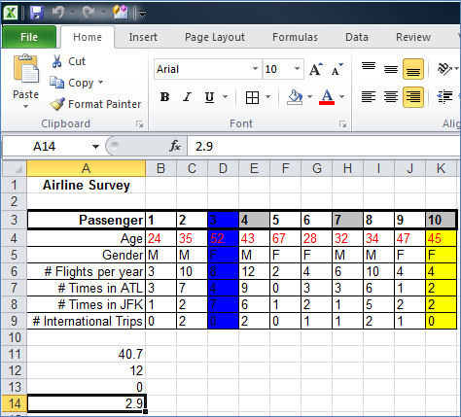
Formulas with Application Object
Example 16: Solution
We use these sub properties of the WorksheetFunction property to make some more calculations.

Slide 60
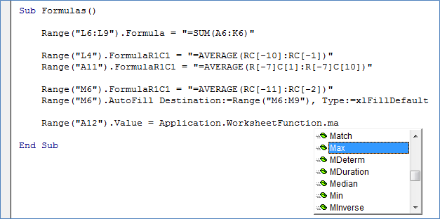
Formulas with Application Object
The Application object uses the WorksheetFunction property to set a function for a cell or range of cells.
The WorksheetFunction property has several sub properties for almost all of the Excel functions
  Max
  Min
  Average
  Sum
  Count

